Slide 1
Linear Regression
Itay Hazan

Slide 2
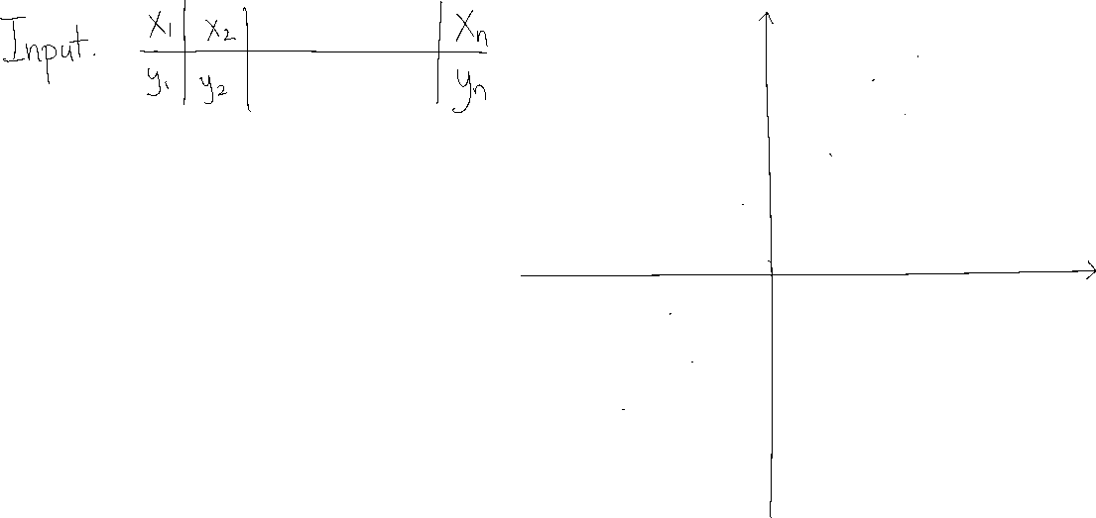
Single-Variable Linear Regression

Slide 3

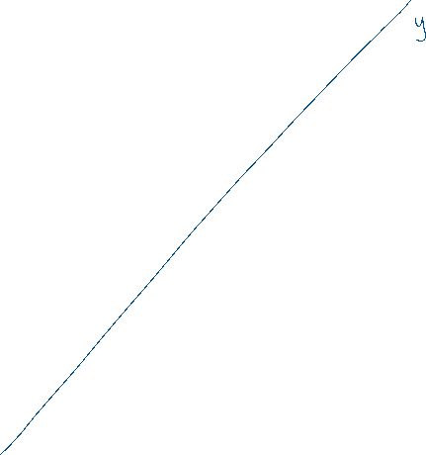




Single-Variable Linear Regression

Slide 4


Single-Variable Linear Regression

Slide 5





Single-Variable Linear Regression

Slide 6


Single-Variable Linear Regression

Slide 7

Single-Variable Linear Regression

Slide 8


Single-Variable Linear Regression

Slide 9













Single-Variable Linear Regression

Slide 10

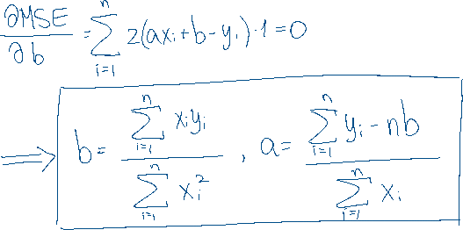
Single-Variable Linear Regression

Slide 11


















Single-Variable Linear Regression

Slide 12








Multivariate Linear Regression

